Slide 1


Clean & Safe
Warewashing
Front & Back of
House
Restroom
Hand Hygiene
Service Personally
Delivered
Foodservice
Cleaner, Safer, Healthier

Slide 2







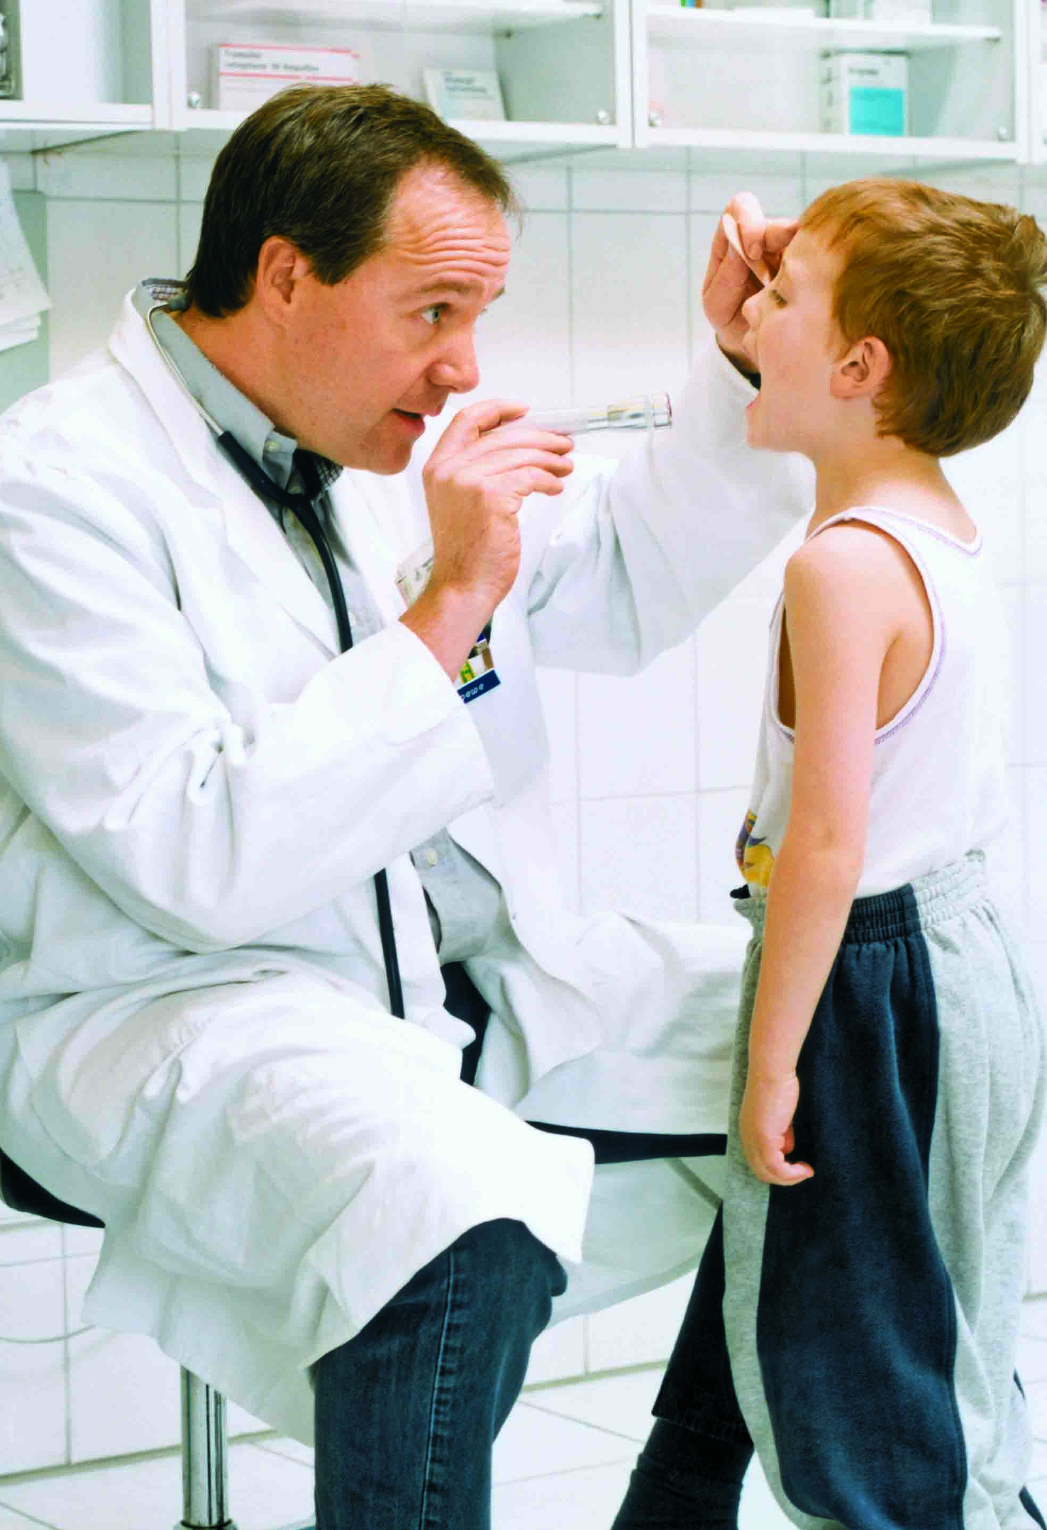
Foodservice – Cleaner, Safer, Healthier
Clean & Safe
Ecolab – Everywhere It Matters
Clean & Safe
Warewashing
Front & Back of
House
Restroom
Hand Hygiene
Service Personally
Delivered
For more than 90 years, we’ve worked behind the scenes to keep food safe, prevent the spread of infection and protect vital resources. And today we’re doing more than ever before.
Ecolab is the global leader in water, hygiene and energy technologies and services. Around the world, businesses in the foodservice, food processing, hospitality, healthcare, industrial, and oil and gas markets choose Ecolab products and services to keep their environments clean and safe, operate efficiently and achieve sustainability goals.
CLEAN WATER
SAFE FOOD
ABUNDANT ENERGY
HEALTHY ENVIRONMENTS

Slide 3



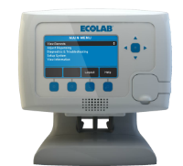
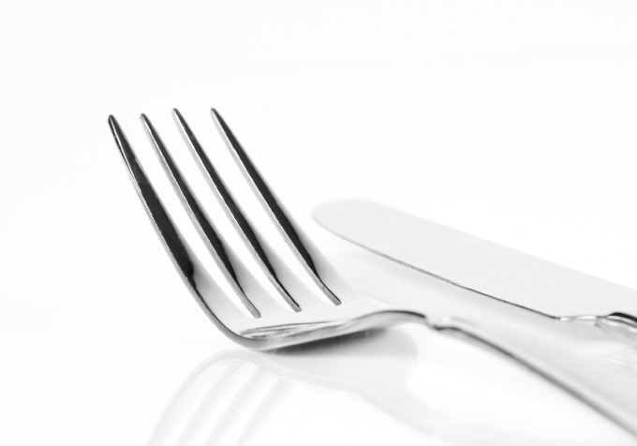


Foodservice – Cleaner, Safer, Healthier
Clean & Safe
Protect Your Customers and your Business
Clean & Safe
Warewashing
Front & Back of
House
Restroom
Hand Hygiene
Service Personally
Delivered
SATISFIED GUESTS
Restaurant cleanliness has a huge impact on your reputation. From spotless dishware to an impeccably clean restroom, Ecolab delivers the results that create loyal customers.
Did you know…
Foodservice customers rank hygiene more important than choice of food, value for money and quality of service*
BETTER BUSINESS RESULTS
Help minimise energy and water costs with our innovative product offerings. Ecolab helps you achieve optimal results at a lower total cost.
SUSTAINABLE SOLUTIONS
Ecolab’s comprehensive solutions have been developed with an eye toward sustainability. Partner with us and help conserve resources and reduce waste.
* Peach Brand Track, Demograph ix/Toluna Nov 2011

Slide 4
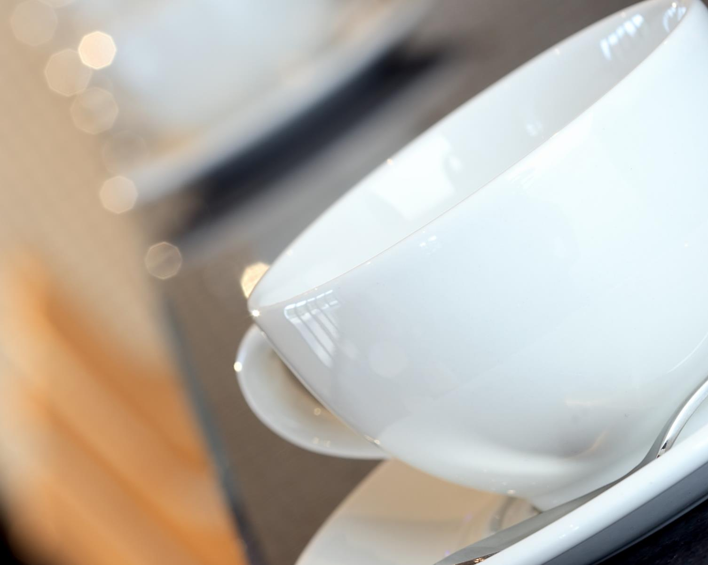


Foodservice – Cleaner, Safer, Healthier
Warewashing
Protect Your Customers and your Business
Clean & Safe
Warewashing
Front & Back of
House
Restroom
Hand Hygiene
Service Personally
Delivered
YOUR KEY CHALLENGES
FIRST PASS RESULTS
COST OF WATER, ENERGY AND WASTE
MACHINE DOWNTIME
EFFICIENT WORKFLOWS
SAFE WORKING ENVIRONMENT
ECOLAB’S WAREWASHING SOLUTIONS DELIVER:
SPOTLESS RESULTS ON ALL DISHES AND CUTLERY
REDUCTION IN YOUR OVERALL IMPACT
THE BEST RESULTS AT THE LOWEST COST IN USE
EMPLOYEE AND CUSTOMER SAFETY
Key Challenges
Warewashing costs
Apex Program
Apex Products
Solids Program
Liquids & Speciality
Racks & Equipment
80% of people say dirty tableware would have a negative impact on their dining experience*
* Study carried out in the UK by Peach Brand Track, Demographix/Toluna, November 2011. (5,000 strong sample).
Notes:
Links done

Slide 5
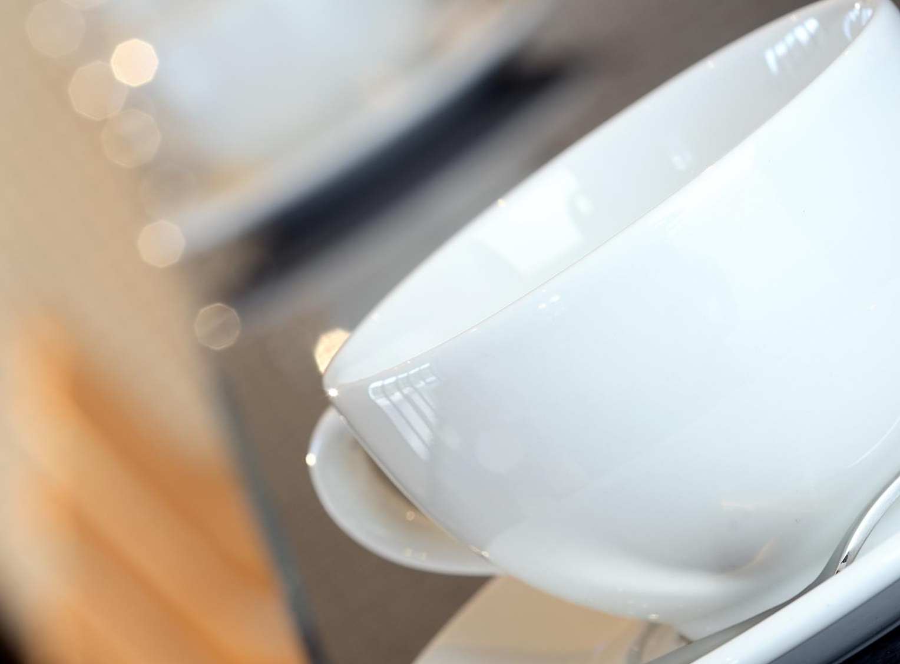


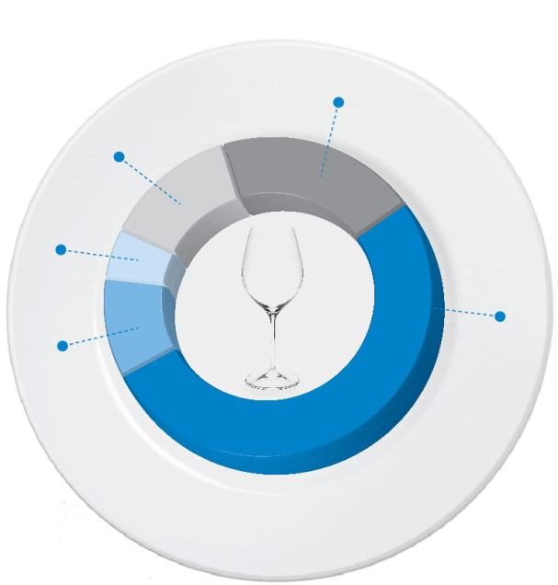
Foodservice – Cleaner, Safer, Healthier
Warewashing
Protect Your Customers and your Business
Clean & Safe
Warewashing
Front & Back of
House
Restroom
Hand Hygiene
Service Personally
Delivered
Average warewash cost allocation:
Key Challenges
Warewashing Costs
Apex Program
Apex Products
Solids Program
Liquids & Speciality
Racks & Equipment
Indirect
20%
Reasons for increased costs:
Staff turnover
Poor training
Poor procedures
Unsolved machine issues
No detergent or rinse aid
Energy & Water
13%
Detergent
5%
Labour
52%
Breakages
10%
Notes:
Links done

Slide 6
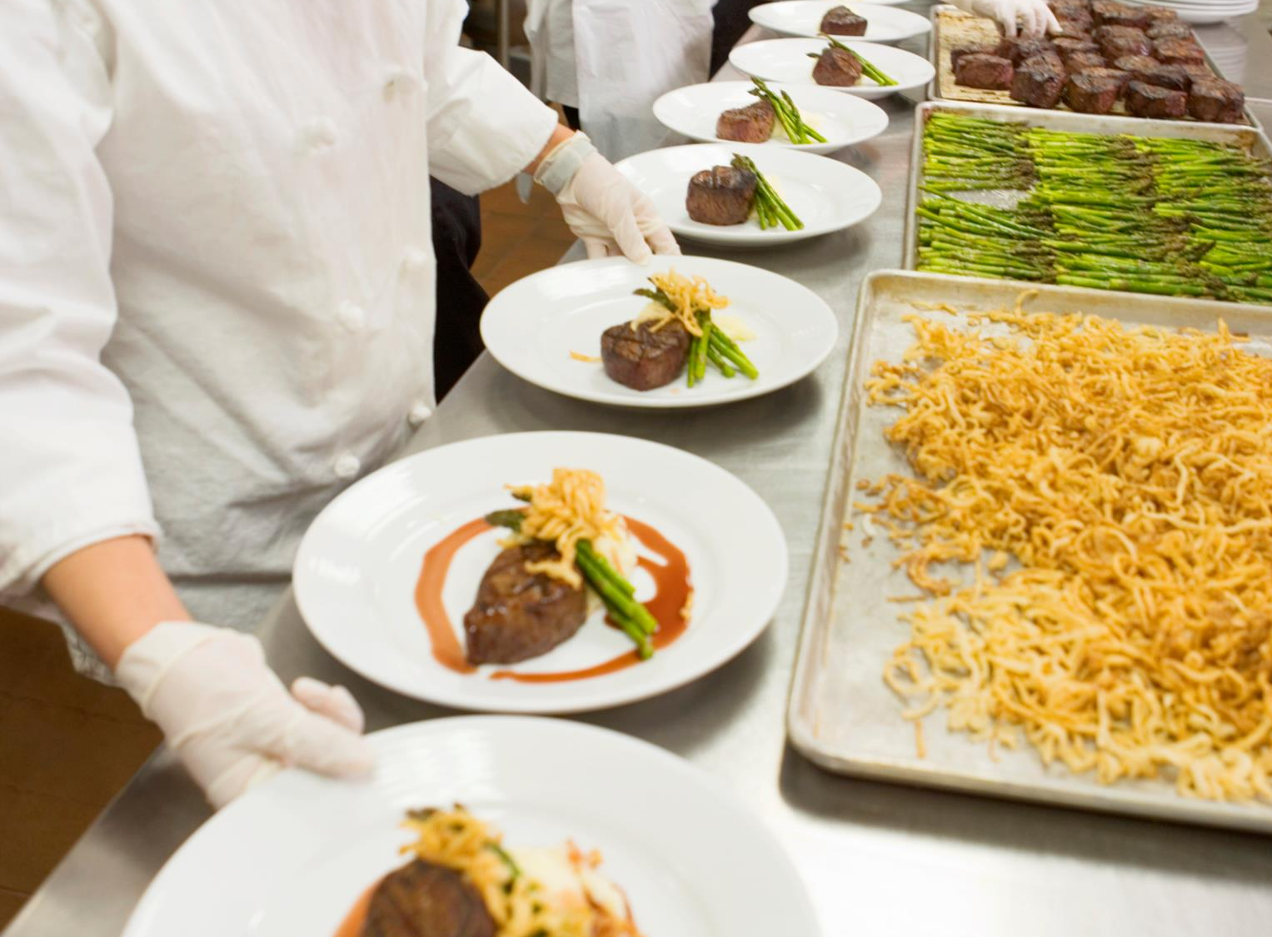


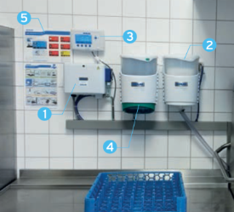
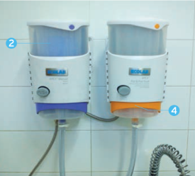




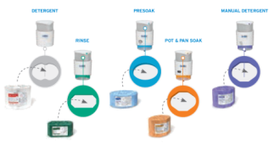
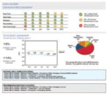

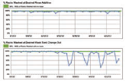
Foodservice – Cleaner, Safer, Healthier
Apex Program
More Control, Made Simple
Clean & Safe
Warewashing
Front & Back of
House
Restroom
Hand Hygiene
Service Personally
Delivered
Learn more about Apex
Advantages of the Apex™ Program
State-of-the-art control system optimises your warewashing procedure
Automatically dispenses at the proper dilution to control costs
Multi-language controller gives you information and metrics to minimise cost and ensure consistent results
Colour-coded, concentrated solid formulations are non-corrosive and easier to handle and drop in
Multi-lingual labels and wallcharts provided
Key Challenges
Warewashing Costs
Apex Program
Apex Products
Solids Program
Liquids & Speciality
Racks & Equipment
HIGH PERFORMING PRODUCTS
INTUITIVE COMMUNICATION
ACTIONABLE MONITORING
SUSTAINABLE IMPACT
All-solid chemistry with controlled dispensing
Audible and visual alarms, language-free training videos
Track efficiency and identify areas needing attention with operating data captured and summarised into an easy-to-read dashboard report
Apex reduces waste as well as the need for rewash, saving water and energy
Notes:
Links done

Slide 7
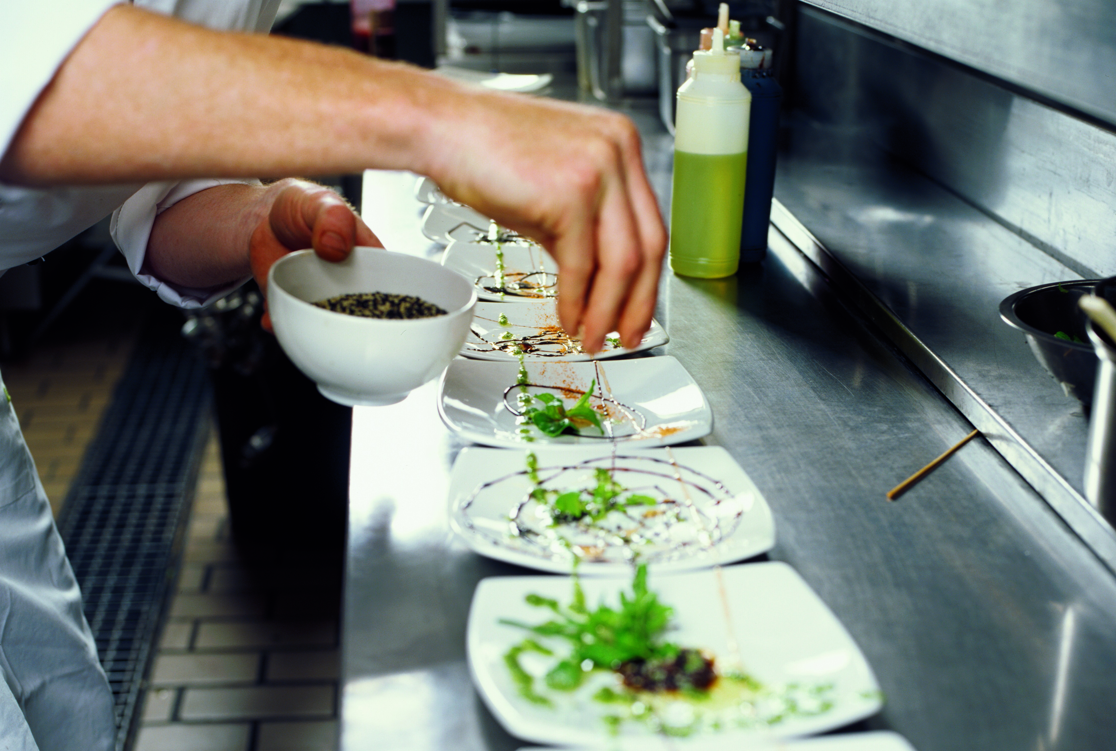
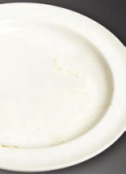
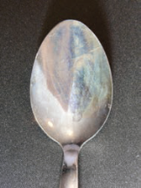
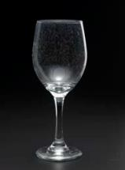
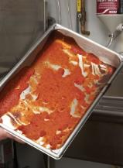
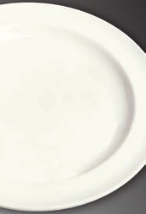
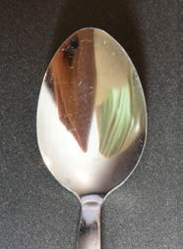

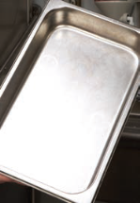
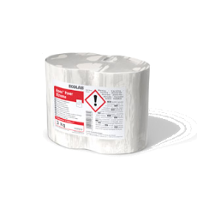
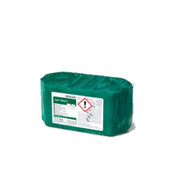


Foodservice – Cleaner, Safer, Healthier
Apex Products
High Performing Products at the Lowest Total Cost
Clean & Safe
Warewashing
Front & Back of
House
Restroom
Hand Hygiene
Service Personally
Delivered
Common Warewashing Problems:
Key Challenges
Warewashing Costs
Apex Program
Apex Products
- Apex Product info
Solids Program
Liquids & Speciality
Racks & Equipment
Rewash required due to improper machine settings and detergent
Spoons have a noticeable film
Glasses show water spots
Without soaking, hard-to-remove soil may require 2 - 4 dishmachine runs
What’s the Apex Solution?
APEX™ Power
Xtreme
Dish machine
Detergent cleans dishes in one pass
APEX™ Presoak
leaves flatware
sparkling clean
and spot-free
APEX™ Rinse N
leaves glasses
sparkling clean and spot-free
APEX™ Pot &
Pan Soak loosens
tough soils delivering
superior results in one
wash
Notes:
Links done

Slide 8
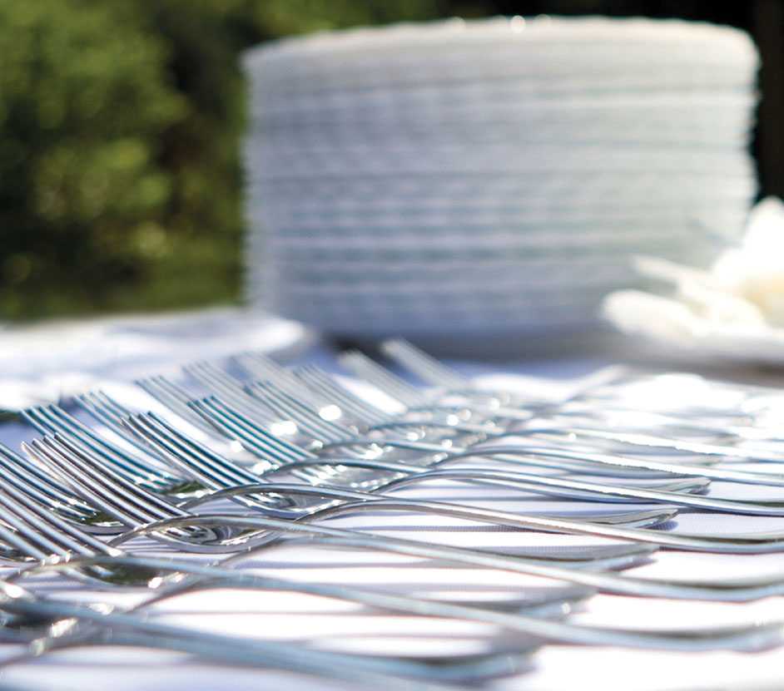













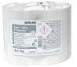
Foodservice – Cleaner, Safer, Healthier
Apex Products
High Performing Products at the Lowest Total Cost
Clean & Safe
Warewashing
Front & Back of
House
Restroom
Hand Hygiene
Service Personally
Delivered
Dish machine Products
Machine Rinse Additives
Manual Pot & Pan Soak
Key Challenges
Warewashing Costs
Apex Program
Apex Products
- Apex Product info
Solids Program
Liquids & Speciality
Racks & Equipment
APEX™ ULTRA Medium-hard water solid machine warewashing detergent with destainer.
4 x 3,1Kg 9080140
APEX™ RINSE HD especially formulated for high total dissolved solid content
2 x 1,1Kg 9087250
APEX™ POT & PAN SOAK Solid detergent for machine warewashing. Formulated to remove soil before putting ware through the machine. 3 x 2,27Kg 9080010
APEX™ ULTRA NC Medium-hard water solid machine warewashing detergent. Ecolabel
4 x 3,0Kg 9087570
APEX™ RINSE N Consistent sparkling and shiny results in soft water conditions. 2 x 1,1Kg 9087190
Flatware Presoak
APEX™ POWER Soft water solid machine warewashing detergent with destainer.
4 x 3,1Kg 9087410
APEX™ RINSE PL Consistent sparkling and shiny results especially on plastic ware.
2 x 1,1Kg 9087310
APEX™ PRESOAK Effectively removes starch and protein film build up on cutlery. Detarnishes silver. 3 x 1,8Kg 9080180
APEX™ POWER XTREME Starch and stain removal in soft-medium water conditions. 4x 3,1Kg 9087070
Manual Pot & Pan Detergent
APEX™ POWER XTRA High soil load detergent in soft-water conditions 4x 3,1Kg 9087130
APEX™ MANUAL DETERGENT Solid manual warewashing detergent. Cuts through grease fast, with minimal scrubbing required. 2 x 1,36Kg 9081050
APEX™ METAL PROTECTION Metal safe solid machine warewashing detergent.4x 3,1Kg 9080940
Notes:
Links done

Slide 9
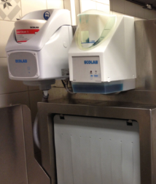



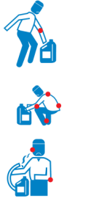


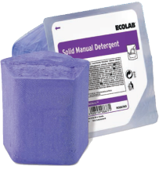
Foodservice – Cleaner, Safer, Healthier
Solids Program
Optimal Service, Superior Results, High Efficiency
Clean & Safe
Warewashing
Front & Back of
House
Restroom
Hand Hygiene
Service Personally
Delivered
In Europe, every day more than 50,000 customer warewashing operations rely on Solid Technology because…
…Performance matters
100% hygienically sparkling results
Unique dosing technology prevents detergent wastage
…Safety matters
Key Challenges
Warewashing Costs
Apex Program
Apex Products
Solids Program
Solid Manual Detergent
Solid Product info
Liquids & Speciality
Racks & Equipment
Find out about NEW
SOLID MANUAL DETERGENT
WITH SOLID MOBILE DISPENSER
Easy Transport
4,5Kg lightweight capsule
Ergonomic Handling
90% less physical strain
Manual Warewashing Performance, Control
& Consistency
100% Closed System
Reduced risk of burns, slips and spills
CLICK HERE>
Notes:
Links done

Slide 10

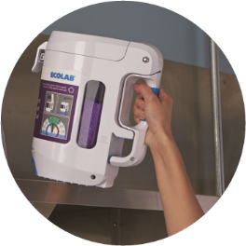

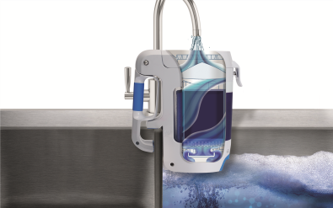


Foodservice – Cleaner, Safer, Healthier
Solid Manual Detergent with Solid Manual Dispenser
Manual Warewashing Performance
Clean & Safe
Warewashing
Front & Back of
House
Restroom
Hand Hygiene
Service Personally
Delivered
It’s now easier than ever to control your warewashing costs whilst maximising your performance with Ecolab’s Solid Manual Detergent
Key Challenges
Warewashing Costs
Apex Program
Apex Products
Solids Program
- Solid Manual Detergent
- Solid Product info
Liquids & Speciality
Racks & Equipment
PERFORMANCE
CONTROL
SUSTAINABILITY
SAFETY
96%
Less
packaging
3X MORE
Solid Manual Detergent washes up to
3X MORE than white label liquid detergents** and is formulated to clean the most difficult food soils
Dispenses the correct amount of detergent eliminating spills, overuse and waste, helping you to manage costs
With no installation or plumbing and 96% LESS PACKAGING WASTE*** the Solid Mobile Dispenser is easy to store and takes up less room.
Solid Chemistry and dispenser fills sinks efficiently, without splash-back
*2013 Ecolab Customer Behaviour Study
**Versus leading White label competitors. Calculation based on 5L water at 50°C and like-for-like concentration recommendation. Ecolab 2015
***vs standard pack
Notes:
Links done

Slide 11

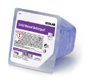
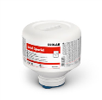
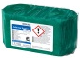

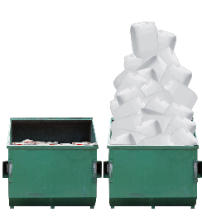
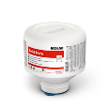


Foodservice – Cleaner, Safer, Healthier
Solids Program
Optimal Service, Superior Results, High Efficiency
Clean & Safe
Warewashing
Front & Back of
House
Restroom
Hand Hygiene
Service Personally
Delivered
Solid Rinse Additives
Solid Warewashing Detergents
Solid Manual Detergent
Key Challenges
Warewashing Costs
Apex Program
Apex Products
Solids Program
- Solid Manual Detergent
- Solid Product info
Liquids & Speciality
Racks & Equipment
SOLID CLEAN M Outstanding washing performance that provides sparkling clean results in all water conditions. Ecolabel 4 x 4,5Kg 9067170
APEX™ RINSE N Consistent sparkling and shiny results in soft water conditions. 2 x 1,1Kg / 9087190
SOLID MANUAL DETERGENT Formulated to clean the most difficult food soils and deliver sparkling results. 2 x 1Kg 9086760
SOLID SPECIAL Maximum performance, washing more dishes per capsule than any other detergent. Effectively removing starch and stains. 4 x 4,5Kg 9005960
SOLID CLEAR DRY CLEAN Super concentrated solid rinse additive. Ecolabel 2 x 1,1 Kg 9073580
SOLID MOBILE STARTER KIT For use with Solid Manual Detergent. The right amount of detergent is dispensed every time, eliminating overuse and waste.1 x Dispenser + 1 x 1Kg Solid Manual Detergent 9086870
SOLID MEGA Outstanding washing and destaining performance that provides sparkling clean results in all water conditions. 4 x 4,5Kg 900588
SOLID HERO Highly effective detergent for exceptional cleaning and destaining results even in the toughest conditions. 4 x 4,5Kg 9081430
Solid Power XL
Sustainable 99.7% phosphate-and phosphorus-free formula
80% Less Waste
SOLID PROTECT Specially designed to wash utensils made of aluminium and other soft metals, whilst protecting delicate materials, like glass. 4 x 4,5Kg 9081470
SOLID DES Outstanding washing and destaining performance, whilst disinfecting at the same time. 4 x 4,5Kg 9038360
Solid Power XL
Liquid Detergent
NEXT PAGE
>
Notes:
Links done
Add Solid clear dry clean? Done
Uk delete 9066630 and 9070320 -done

Slide 12
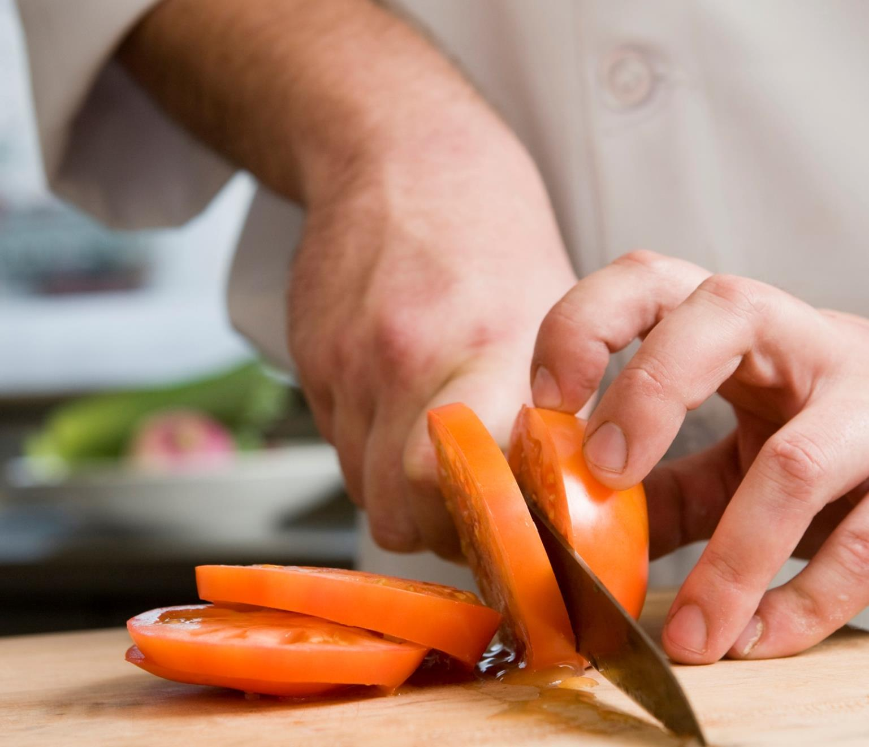
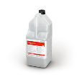

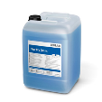
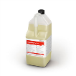
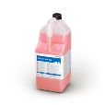
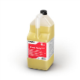
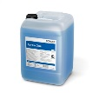



Foodservice – Cleaner, Safer, Healthier
Liquids and Speciality
Effective Solutions for Your Tableware Needs
Clean & Safe
Warewashing
Front & Back of
House
Restroom
Hand Hygiene
Service Personally
Delivered
Powder Warewashing Tablets
Liquid Rinse Additives
Liquid Warewashing Detergents
Key Challenges
Warewashing costs
Apex Program
Apex Products
Solids Program
Liquids & Speciality
Racks & Equipment
TRUMP XL SPECIAL Exceptional cleaning results at optimum cost. 4 x 5L 9054810
ECO-CLIN TABS 88 Easy-to-dose tablets, delivering outstanding cleaning and bleaching performance in all water conditions. 4 kg 903430
CLEAR DRY CLASSIC Reduces spotting and dry time for higher efficiency. 2 x 5L 901366
TRUMP METAL PRO SPECIAL Excellent cleaning performance. Specially designed to wash utensils made of aluminium and other soft metals. 2 x 5L 9076940
CLEAR DRY HDP PLUS Sparkling and shiny results even in the toughest water conditions. 2 x 5L 9051130
TRUMP HYDRO SPECIAL Highly effective detergent for superior cleaning results even in the toughest conditions. 4 x 5L 9054720
TOPRINSE CLEAN Neutral rinse additive for undercounter and hood-type machines. Ecolabel
2 x 5L 9046380
TOPMATIC HERO Highly effective detergent for exceptional cleaning and destaining results even in the toughest conditions. 4 x 5L 9036190
TOPRINSE CRYSTAL Glass machine liquid rinse aid. Accelerates the drying process to prevent watermarks. Use with Topmatic Crysal GB Special
2 x 5L 9028640
TOPMATIC CRYSTAL GB SPECIAL Specially formulated for washing glassware to give clean sparkling results. Suitable for all types of cabinet glasswashing machines. For best results use with Toprinse Crystal. 4 x 5L 9057580
NEXT PAGE
>
Notes:
Links done
UK keep topmatic hero 9036190 4 x 5l done clean 9054860 4 x 5l, crystal 90575804 x 5
Trump keep, hydro sp 9054720 4 x 5 done , XL sp 9054810 4 x 5,, metal pro 9076940 2 x 5 - done
Delete guardian – can we put ecoclin in even if not master assortment? done
Eco-clin Tabs 88 903430 4 kg
Rinse for uk keep clear dry classic 901366 (delete the last 0)hdp plus 9051130, done
If we can add in two there may be a couple to add in or are we sticking to master / core/ deleting?
For uk need Toprinse Crystal 9028640 4x5 l
Liquid rinse additive - use with Topmatic Crystal GB Special
But we might need to add this into the detergnet bit of have a glasswash section?
Topmatic Crystal GB Special 9057580 4x5 l
Liquid machine glasswashing detergent for sparkling results - use with Toprinse Crystal
Clean just keep 9046380 2 x 5 done

Slide 13




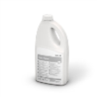
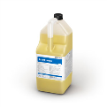
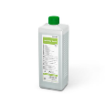



Foodservice – Cleaner, Safer, Healthier
Liquids and Speciality
Effective Solutions for Your Tableware Needs
Clean & Safe
Warewashing
Front & Back of
House
Restroom
Hand Hygiene
Service Personally
Delivered
Manual Warewashing
Delimers
Presoak
SOLID LIME-A-WAY High performing solid delimer for dishwashers and other kitchen appliances. Easy to dose and avoids product splashes and spillages. 6 x 600g 9080220
APEX™ PRESOAK Cutlery presoak solid detergent for machine warewashing. Effectively removes starch and protein film build up. Detarnishes silver. 3 x 1,8Kg 9080180
ASSURE POWDER Powder presoak detergent. Excellent cleaning performance on protein stains keeping cutlery shiny. 6 x 2.4Kg 903520
DIP-IT PLUS Presoak powder detergent for use on all types of crockery and kitchen utensils. Removes even the toughest coffee and tea stains and starch build up. 6 x 2.4Kg 903674 , 10Kg 903328
Key Challenges
Warewashing costs
Apex Program
Apex Products
Solids Program
Liquids & Speciality
Racks & Equipment
APEX MANUAL DETERGENT Ultra high concentrate detergent that delivers excellent grease removal at optimal operational cost. 2 x 1,36Kg 9081050
KITCHENPRO MANUAL Perfume and colour-free, high concentrate detergent that delivers maximum cleaning performance. Simple and easy to dose. 2 x 2L 9081910
LIME-A-WAY EXTRA High performance liquid delimer, removes even the most stubborn lime build up. 2 x 5L 9035260
LIME-A-WAY SPECIAL Mild liquid delimer, for use in food contact utensils, such as coffee machines, kettles, beverage fountains. 4 x 1L 903760
ASSERT LEMON Excellent cleaning performance with a pleasant lemon fragrance. 6 x 1L 903227 , 2 x 5L 9031660,
ASSERT CLEAN Excellent cleaning performance. Colour and perfume free. Ecolabel 2 x 5L 9031270
PANTASTIC DISINFECTANT PK Wash and disinfect crockery and kitchen utensils in just one step. 2 x 5L 9081490
<
PREVIOUS PAGE
Notes:
Links done
Uk apex manual 9081050, kp fine, assert 9031660, 903227 (no 0 at end), clean 9031270 only, keep pk done
we are majorly going to have to update the price list as loads are in stock but not on price list – and need to check simplification!
Solid limeawy fine
Limeaway extra only 5l keep - done
Limeaway special delete the last 0 in code done
Apex presaok fine
Assure 903520 delete last 0 done
Codes for dipit shorter too 903674 and 903328 - done
Delete assure plus and dip it liquid - done

Slide 14
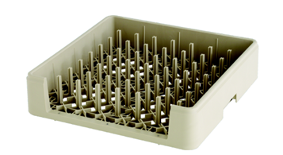
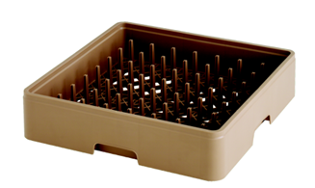
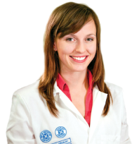
Foodservice – Cleaner, Safer, Healthier
Warewashing Racks and Equipment
Optimise Results with Correct Maintenance & Racking
Clean & Safe
Warewashing
Front & Back of
House
Restroom
Hand Hygiene
Service Personally
Delivered
Better Results
Reduce Breakage
Key Challenges
Warewashing costs
Apex Program
Apex Products
Solids Program
Liquids & Speciality
Racks & Equipment
- Racks & Equipment info
Increase Efficiency
Open design – to clean every part
Drain bar – less spotting, better drying
Less breakage – save costs
Easy handling – reduce work accidents
Protection – tested durability
“We have people who are very specialised in all areas of warewashing creating a cohesive team. The result is cleaner ware for our customers and an improved experience for their guests.”
Jenna Johnson, Ecolab Research & Development
Notes:
Links done

Slide 15








Foodservice – Cleaner, Safer, Healthier
Warewashing Racks and Equipment
Optimise Results with Correct Maintenance & Racking
Clean & Safe
Warewashing
Front & Back of
House
Restroom
Hand Hygiene
Service Personally
Delivered
Open Racks
Silverware Racks
Mats
Key Challenges
Warewashing costs
Apex Program
Apex Products
Solids Program
Liquids & Speciality
Racks & Equipment
- Racks & Equipment info
8 ROW HIGHWALLL PLATE PEG RACK This high wall rack has 8 rows that are 2" apart. The peg height is 2 1⁄4". This sturdy rack holds plates at the correct angle for thorough washing. The high walls of this rack are specially designed to accommodate larger plates. 5020-M
9295-7059 (brown)
FULL SIZE OPEN RACK
These utility racks with solid walls are ideal for almost any bowl, cup or oddly shaped item. 6000-M . 3 5⁄8" H
9291-8010 (beige)
8 ROW OPEN END RACK
This rack will hold 8 trays less than 18" long or 6 trays that are longer than 18". This sturdy rack holds trays at the
correct angle for thorough washing. Peg height is 1 3⁄4". 5020-MX
9295-7505 (beige)
FULL SIZE OPEN SILVERWARE RACKS
Use this rack for silverware or utensils. The moulded-in grid is specially designed for flatware and permits maximum wash action while retaining the smallest pieces. Solid Walls 6411-M . 3 5⁄8” H
9293-7515 (beige)
8 COMPARTMENT SILVERWARE BASKET
Measures 16 3⁄4" W x 8" D x 6" H.
Not designed to be used with
square baskets. Can be used
in place of cylinder carrier washer.
Plastic 9290-2501 (shown)
Stainless Steel 9290-2618
PREMIUM GREASE PROOF MAT
Heavy-duty grease-proof mat that will retain its shape and continue to help prevent slips and falls even in high grease
environments
Ideal for areas with exposure to grease
. Dishmachine area
. Bar area
. Food prep line
9297-2926
Size 3' x 5'
Please contact your Ecolab associate for rack availability

Slide 16
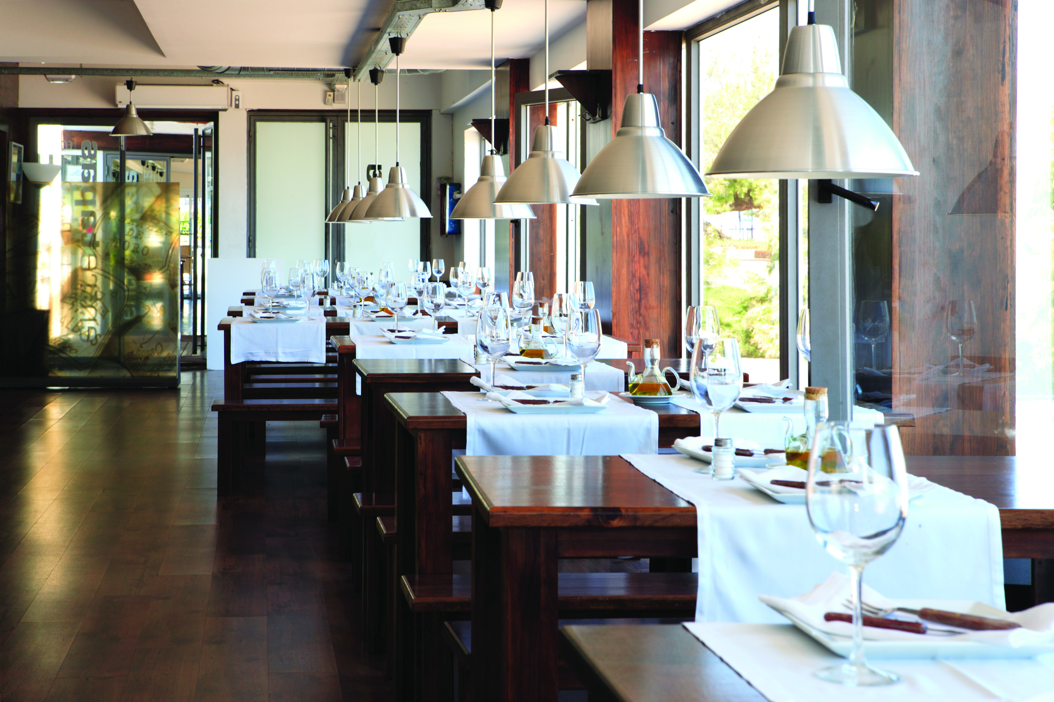


Foodservice – Cleaner, Safer, Healthier
Front & Back of House
Clean & Safe
Warewashing
Front & Back of
House
Restroom
Hand Hygiene
Service Personally
Delivered
Why Clean Matters
With decades of Foodservice experience, Ecolab understands how important food safety, hygiene and cleanliness are to your restaurant operations.
We provide the high performance products, easy to use systems, expert service and training needed to effectively and economically meet your hygiene challenges.
Ecolab’s industry leading, innovative, high performance cleaning solutions and systems make it easier to deliver the experience your customers expect and deserve.
Why Clean Matters
Key Challenges
KitchenPro
Floor & Drain
Multi-Surface Cleaners
Grease Removal
Speciality
Front & Back of House Challenges
>

Slide 17

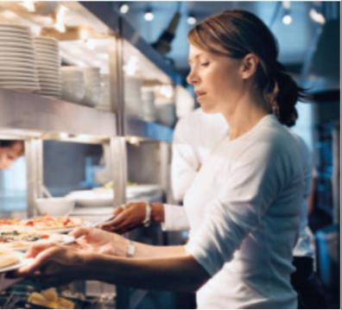
Foodservice – Cleaner, Safer, Healthier
Front & Back of House
Clean & Safe
Warewashing
Front & Back of
House
Restroom
Hand Hygiene
Service Personally
Delivered
Front of house
Eating is a sensory experience in more ways than the food you serve. Long before taste, your customer’s impression has been formed by other senses. No matter how clean and hygienic your kitchen is, the appearance and ambiance of eating areas form the basis of your customer’s experience.
Back of house
Why Clean Matters
Key Challenges
KitchenPro
Floor & Drain
Multi-Surface Cleaners
Grease Removal
Speciality
YOUR KEY CHALLENGES:
CREATING THE RIGHT DINING EXPERIENCE
CLEAN AND HYGIENIC SERVICE AND DISPLAYS
CLEAN, HYGIENIC RESTROOMS
MAINTENANCE OF FURNISHINGS AND FITTINGS
WHAT CAN ECOLAB’S SOLUTIONS DO FOR YOU?
DELIVER THE HIGHEST STANDARD OF FRONT OF HOUSE CLEANLINESS AND HYGIENE COMPLIANCE
MAKE IT EASIER TO DELIVER THE EXPERIENCE YOUR CUSTOMERS EXPECT
EXTEND THE LIFE AND RETAINS THE LOOK OF VALUABLE FURNISHINGS AND FITTINGS
ENSURE DINING AREAS REFLECT YOUR ATTENTION TO CLEANLINESS

Slide 18


Foodservice – Cleaner, Safer, Healthier
Front & Back of House
Clean & Safe
Warewashing
Front & Back of
House
Restroom
Hand Hygiene
Service Personally
Delivered
Front of house
On average foodservice outlets operate for more hours per week compared to 20 years ago. For users this presents challenges and you can’t afford to compromise when it comes to ensuring a clean, safe and efficient operation.
Back of house
Why Clean Matters
Key Challenges
KitchenPro
Floor & Drain
Multi-Surface Cleaners
Grease Removal
Speciality
YOUR KEY CHALLENGES:
PREVENTION OF CROSS-CONTAMINATION
EFFICIENT USE OF KITCHEN EQUIPMENT
REDUCTION OF SLIP, CHEMICAL AND FIRE HAZARDS
LOSS OF FOOD WASTED THROUGH SPOILAGE
ECOLAB’S SOLUTIONS DELIVER:
CROSS-CONTAMINATION PREVENTION
COMPLIANCE WITH FOOD SAFETY STANDARDS
ECONOMICAL USE OF DETERGENTS AND DISINFECTANTS
IMPROVED EFFICIENCY THROUGH REDUCED CLEANING TIME

Slide 19
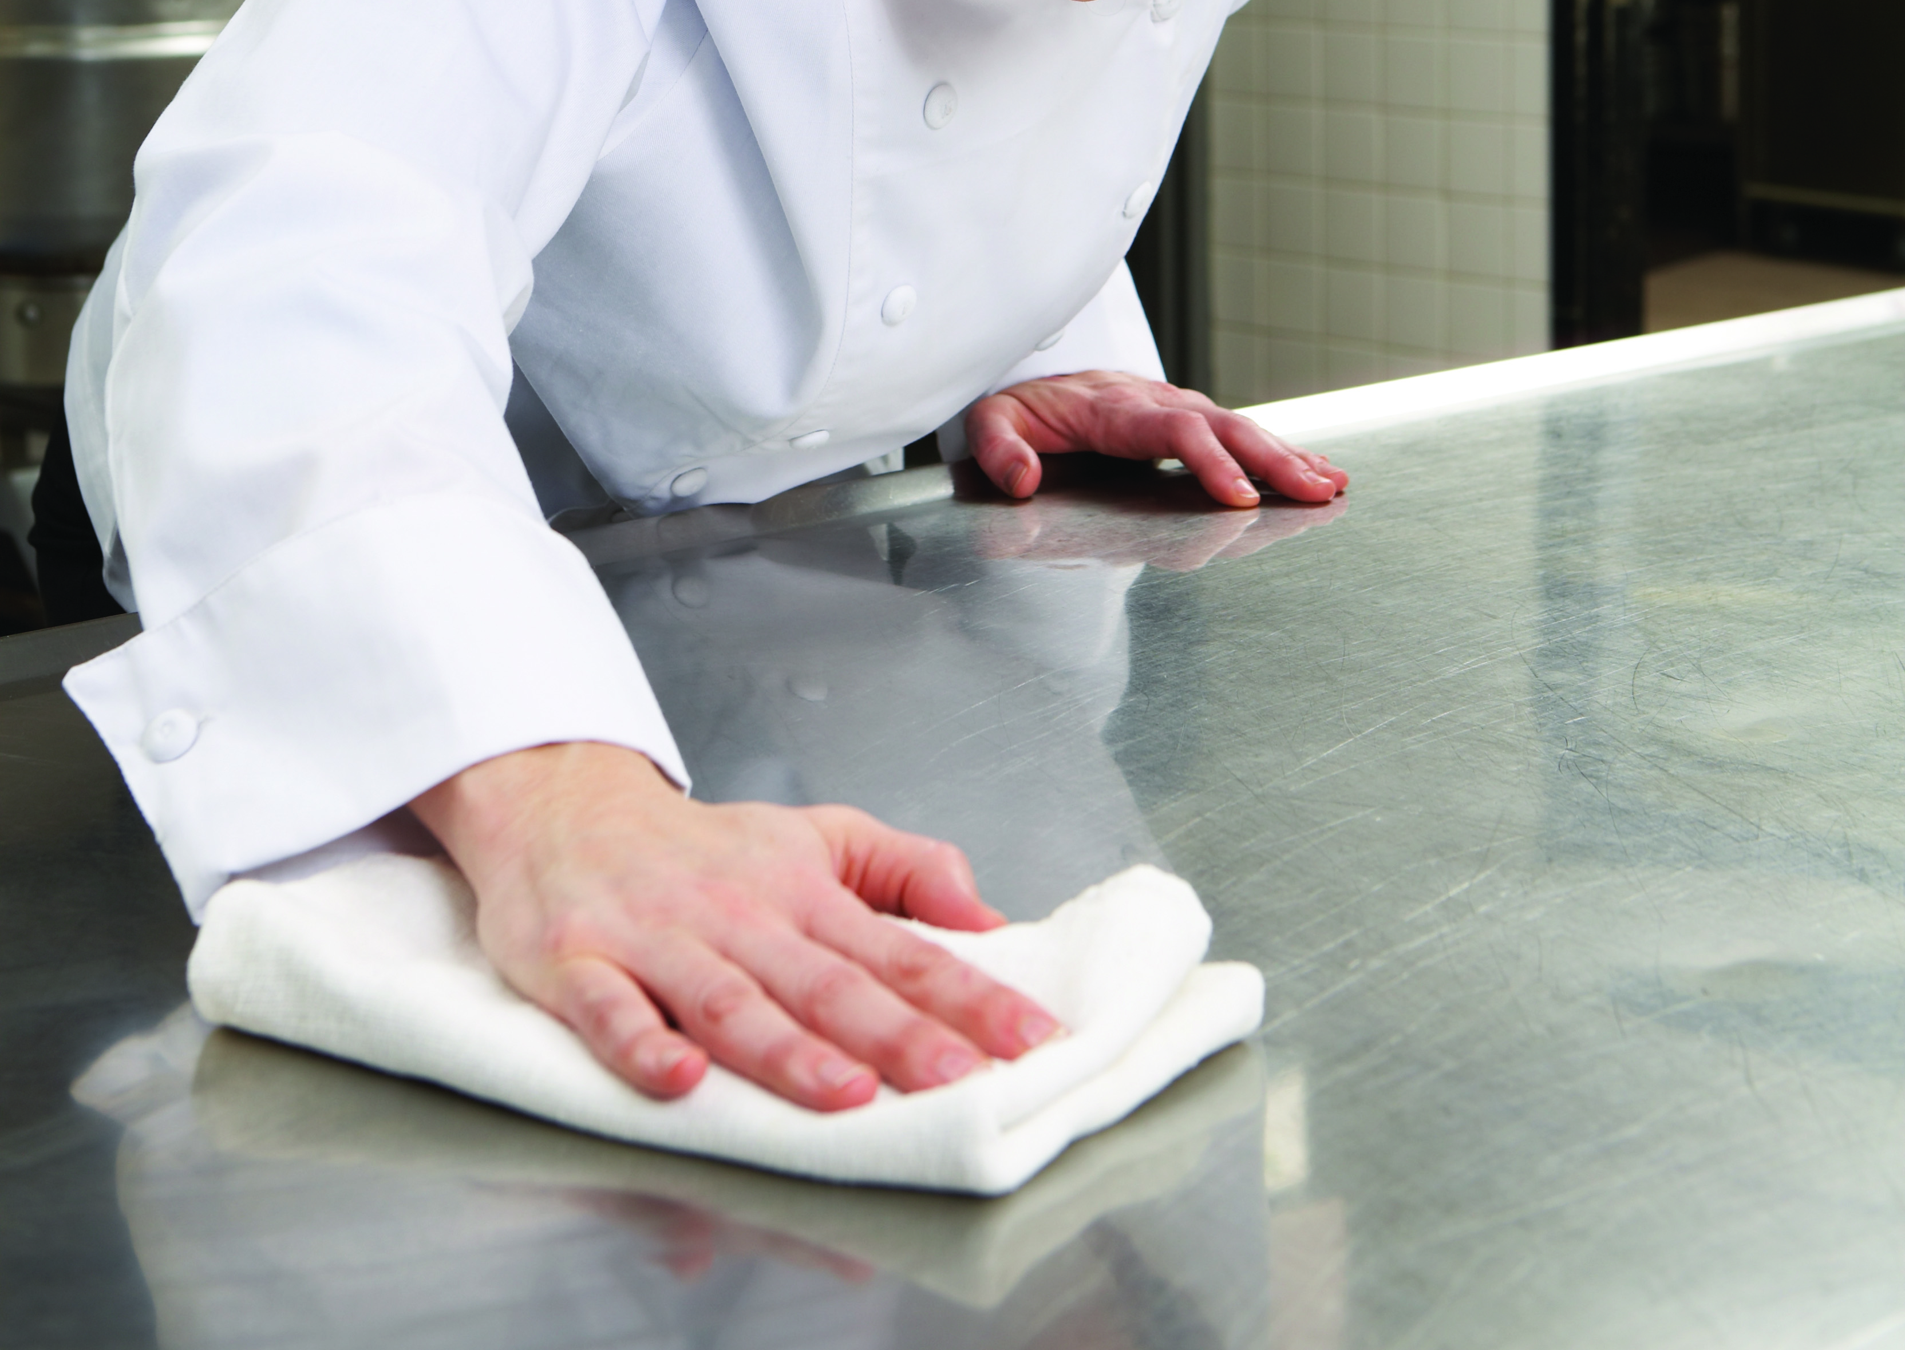


Foodservice – Cleaner, Safer, Healthier
KitchenPro
Superior Results, Controlled Dispensing, Easy-to-Use
Clean & Safe
Warewashing
Front & Back of
House
Restroom
Hand Hygiene
Service Personally
Delivered
Advantages of the KitchenPro dispensing system
Innovative products and systems
Lock and key dispensers
Saves time and controls costs
Safely achieve hygienically clean results
No PPE required
Fast one handed filling of spray bottles or buckets
Multi-lingual labels and wallcharts provided
Why Clean Matters
Key Challenges
KitchenPro
- KitchenPro info
Floor & Drain
Multi-Surface Cleaners
Grease Removal
Speciality
Get More
Spend Less
Reduce Waste
=

Slide 20










Foodservice – Cleaner, Safer, Healthier
KitchenPro
Superior Results, Controlled Dispensing, Easy-to-Use
Learn more about KitchenPro
Clean & Safe
Warewashing
Front & Back of
House
Restroom
Hand Hygiene
Service Personally
Delivered
Kitchenpro
KITCHENPRO WASH´N WALK No rinse kitchen floor cleaner removes incrusted grease over time for cleaner and safer floor. 2 x 2L 9081930
KITCHENPRO FLOOR Powerful kitchen floor cleaner for all cleaning processes: Mop, Scrub, Spray. 2 x 2L 9081870
KITCHENPRO MANUAL Perfume and colour-free, high concentrate detergent that delivers maximum cleaning performance. Simple and easy to dose. 2 x 2L 9081910
GREASELIFT Highly concentrated grill cleaner and degreaser that requires no gloves or goggles in the ready to use solution. 2 x 2L 9079400
KITCHENPRO DES SPECIAL Bactericidal and yeasticidal cleaner and disinfectant 2 x 2L 9079720
KITCHENPRO AZIDES Acidic cleaner and disinfectant combining deliming and disinfection in one step. 2 x 2L 9082010
Why Clean Matters
Key Challenges
KitchenPro
- KitchenPro info
Floor & Drain
Multi-Surface Cleaners
Grease Removal
Speciality
Use biocides safely. Always read the label and product information before use.
Notes:
UK delete duo and des

Slide 21









Foodservice – Cleaner, Safer, Healthier
Floor and Drain
Floor Cleaning Solutions
Clean & Safe
Warewashing
Front & Back of
House
Restroom
Hand Hygiene
Service Personally
Delivered
Problem
Solution
Why Clean Matters
Key Challenges
KitchenPro
Floor & Drain
- Floor & Drain info
Multi-Surface Cleaners
Grease Removal
Speciality
KitchenPro Wash’n Walk is a no-rinse floor cleaner for foodservice areas. Patented formula uses special enzymes to break down all types of kitchen grease for superior cleaning.
…present serious slip and trip hazards, especially near grills and fryers
Wash’n Walk Attacks the greasy build up on slippery kitchen floors, helping reduce slips and falls
Clean and Clog-free Drain
Problem
Solution
WEEK 0
WEEK 1-3
WEEK 3-6
Wash ‘n Walk® removes
the packed in grease
from grout lines
Grease bank
full
Grease bank
half-empty
Grease bank
empty

Slide 22








Foodservice – Cleaner, Safer, Healthier
Floor and Drain
Floor Cleaning Solutions
Clean & Safe
Warewashing
Front & Back of
House
Restroom
Hand Hygiene
Service Personally
Delivered
Floor Cleaners
Drain Cleaners
Cleaning tools
KITCHENPRO WASH´N WALK No rinse kitchen floor cleaner removes incrusted grease over time for cleaner and safer floor. 2 x 2L 9081930
KITCHENPRO FLOOR Powerful kitchen floor cleaner for all cleaning processes: Mop, Scrub, Spray. 2 x 2L 9081870
OASIS PRO 33 PREMIUM Highly concentrated floor cleaner suitable for all floor types with special dirt removal technology. 2 x 2L 9053570
FREEDRAIN Biological liquid drain and grease traps maintenance cleaner.
4 x 5L 902161
BLIZZARD COMBIPACK Starter kit for floor cleaning consisting of single castor bucket, mop holder and handle as well as a flat cotton mop. Starter Kit, 40cm holder, single castor 8129
Blizzard Mop with Clip replacement head also available 8100
RASANT XPRESS MINI Starter kit for front of house floor cleaning consisting of bucket, mop holder and handle and a microfibre mop. Starter Kit 8161
RASANT XPRESS MINI MOP
Rasant Xpress mini mop 1 x 1 8166
Why Clean Matters
Key Challenges
KitchenPro
Floor & Drain
- Floor & Drain info
Multi-Surface Cleaners
Grease Removal
Speciality
MAXX MAGIC2 Super-wetting floor cleaner suitable for all kind of floors like tiles, vinyl, natural and artificial stones. The super-wetting technology removes light to heavy dirt ingrained deep in the pores of the floor. Ecolabel 12 x 1L 9084460 , 2 x 5L 9084500

Slide 23








Foodservice – Cleaner, Safer, Healthier
Multi-Surface Cleaners
Effective Multi-Surface Cleaners and Food Contact Disinfectants
Clean & Safe
Warewashing
Front & Back of
House
Restroom
Hand Hygiene
Service Personally
Delivered
Remove Greasy Soil or Film Easily
Streak-Free Glass Every time
Why Clean Matters
Key Challenges
KitchenPro
Floor & Drain
Multi-Surface Cleaners
- Multi–Surface Cleaners info
Grease Removal
Speciality
Oasis Pro 16 Premium
MAXX Windus C2
Ensure Safety with Disinfected Surfaces
Maintain Correct Chemical Levels
KitchenPro Des Special
Dosing Station
Use biocides safely. Always read the label and product information before use.
Notes:
OP 20?

Slide 24










Foodservice – Cleaner, Safer, Healthier
Multi-Surface Cleaners
Effective Multi-Surface Cleaners and Food Contact Disinfectants
Clean & Safe
Warewashing
Front & Back of
House
Restroom
Hand Hygiene
Service Personally
Delivered
Multi Surface Cleaners
Glass Cleaners
Cleaning Tools
OASIS PRO 16 PREMIUM Concentrated multi purpose cleaner and degreaser - with excellent cleaning properties on all kitchen surfaces. 2 x 2L 90591920
KITCHENPRO DES SPECIAL Concentrateed bactericidal and yeasticidal cleaner and disinfectant 2 x 2L 9079720
KITCHENPRO AZIDES Concentrated acidic cleaner and disinfectant combining deliming and disinfection in one step. 2 x 2L 9082010
MIKRO-QUAT CLASSIC Colour-coded cleaner & disinfectant for the kitchen area. 2 x 5L 9044140
OASIS PRO 20 PREMIUM Concentrated all purpose cleaner disinfectant that kills germs and fungi on all food preparation areas and equipment. 2 X 5L 9051700
DESGUARD 20 Light-duty cleaner
For all washable kitchen equipment and surfaces. Bactericidal and fungicidal
4 x 1L 900819
MAXX WINDUS C2 Ready-to-use glass cleaner for windows, mirrors, glass, plastic etc. Ecolabel 12 x 750ml 9084640
MICROFIBRE CLOTHS POLIFIX Strong, durable, easy-rinse microfibre cloths . 1 x 5 pcs Blue: 8167, Yellow: 8173, Green: 8171, Red: 8168
6L BUCKETS Durable, chemical resistant 6L buckets – full colour coding available.
1 x 6L Blue: 8119 , Yellow: 8120, Red: 8118 White: 8121
Food Contact Surface Disinfectants
OASIS PRO 40 PREMIUM Highly concentrated glass cleaner for streak-free, fast drying performance. 2 x 2L 9053590
Why Clean Matters
Key Challenges
KitchenPro
Floor & Drain
Multi-Surface Cleaners
- Multi–Surface Cleaners info
Grease Removal
Speciality
Use biocides safely. Always read the label and product information before use.
Notes:
Remove KP des and keep special DONE

Slide 25










Foodservice – Cleaner, Safer, Healthier
Grease Removal
Fast Solutions for High Food Quality and a Safer Kitchen
Clean & Safe
Warewashing
Front & Back of
House
Restroom
Hand Hygiene
Service Personally
Delivered
Common problems caused by grease:
Why Clean Matters
Key Challenges
KitchenPro
Floor & Drain
Multi-Surface Cleaners
Grease Removal
- Grease Removal info
Speciality
The Ecolab solution:
Grease Express
Fast Acting Grill Cleaner
Absorbit
Easy to use and effective fryer cleaner
Greaselift
Powerful formula for easy oven cleaning
Learn more about Greaselift

Slide 26










Foodservice – Cleaner, Safer, Healthier
Grease Removal
Fast Solutions for High Food Quality and a Safer Kitchen
Clean & Safe
Warewashing
Front & Back of
House
Restroom
Hand Hygiene
Service Personally
Delivered
Grill Cleaners
Automatic Oven Cleaners
Fryer High-Temperature
GREASELIFT Highly concentrated grill cleaner and degreaser that requires no gloves or goggles in the ready to use solution. 2 x 2L 9079400
GREASESTRIP PLUS features a unique gel formula that provides 100% of surface contact. 2 x 5L 9031970 3 x 1,3L 900469
GREASECUTTER PLUS a highly effective ready to use grill cleaner & degreaser. It destroys the toughest grease and soil deposits and with the specially designed sprayer, the product is easy and simple to use. 2 x 5L 904269
OVEN CLEANER POWER used in ovens with integrated cleaning system. It removes even the toughest food soils and grill residues in one cleaning cycle thereby saving time and labour costs.
4 x 5L 9019640
OVEN RINSE POWER Neutralises the alkalinity in the cooking cabinet and removes lime residues which are built during the cooking process and leaves a dry, hygienic and sparkling clean surface. Use combined with Oven Cleaner Power. 2 x 5L 9021430
GREASELIFT RTU Effective degreaser that requires no gloves or goggles to clean ovens, grills, stove hoods and vents. 6 x 750ml 9080580
GREASECUTTER FAST FOAM Greasecutter Fast Foam is an effective heavy duty grill cleaner & degreaser. This foam formulation clings to vertical surfaces rapidly removing stubborn and carbonised grease.
4 x 750ml 9052810
GREASE EXPRESS Fast acting formula for high temp applications.
4 x 1L 902716
ABSORBIT Heavy-Duty powder detergent for grills and fryers.
6 x 2,2Kg 902421
Why Clean Matters
Key Challenges
KitchenPro
Floor & Drain
Multi-Surface Cleaners
Grease Removal
- Grease Removal info
Speciality
Kitchen Degreasers

Slide 27









Foodservice – Cleaner, Safer, Healthier
Speciality
Effective Solutions for Your Unique Needs
Clean & Safe
Warewashing
Front & Back of
House
Restroom
Hand Hygiene
Service Personally
Delivered
Remove Spots and Stains from Your Carpet
Clean and Polish All Metal Areas
Why Clean Matters
Key Challenges
KitchenPro
Floor & Drain
Multi-Surface Cleaners
Grease Removal
Speciality
- Speciality info
Carpet B
Chromol
Keep Your Freezer Clean
Eliminate Bad Odours
Freezer Cleaner
Oasis Pro 56 Premium

Slide 28









Foodservice – Cleaner, Safer, Healthier
Speciality
Effective Solutions for Your Unique Needs
Clean & Safe
Warewashing
Front & Back of
House
Restroom
Hand Hygiene
Service Personally
Delivered
Odour Counteractants
Freezer Cleaners
Stainless Steel Cleaners/Polishers
KRISTALIN BIO Bathroom cleaner and odour counteractant based on natural ingredients. Eliminates the root cause of bad smell at source. Also suitable for waste management areas. 2 x 5L 302790
OASIS PRO 56 PREMIUM Highly concentrated air freshener with winter escape fragrance. 2 x 2L 9051860
FREEZER CLEANER Works effectively without defrosting the freezer. No need to wait for freezer temperature to rise before cleaning. Entire freezer cleaning operation takes less time. 2 x 5L 9009590
CARPET A Reliable spot and stain remover which enables the removal of water soluble soils such as fruit juices, cola, fresh coffee, tea and ice cream. Removes stains rapidly penetrating deep into the fabric. 6 x 500ml 300578
CARPET B Reliable spot and stain remover which enables the removal of oil and fat based stains e. g. coloured pencil, shoe polish, butter, cream, floor polish, tar. Protects textiles against reoccurring stains and thereby providing a sustainable impeccable visual effect. 6 x 500ml 301835
CHROMOL Ready to use polish removes light soil and restores shine. Protection helps to keep out soil and moisture. Safe on all metal surfaces and kitchen equipment. 6 x 500ml 902939
COPPER SHINE SPECIAL Ready to use soft metal cleaner for e.g. copper.
6 x 500ml 9042750
PRO SHINE SPECIAL Furniture polish for wooden surfaces e.g. Teak, Oak, Mahogany, as well as polished and painted surfaces. Leaves a protective film against fingerprints, water rings and settled dust. Pro shine special ensures a streak-free application with a pleasant scent. 6 x 500ml 302999
Why Clean Matters
Key Challenges
KitchenPro
Floor & Drain
Multi-Surface Cleaners
Grease Removal
Speciality
- Speciality info
Carpet Spot Removers

Slide 29



Foodservice – Cleaner, Safer, Healthier
Restroom
Spotless Restrooms Help Keep Your Guests Happy
Clean & Safe
Warewashing
Front & Back of
House
Restroom
Why Clean Matters
Key Challenges
Restroom solutions
Hand Hygiene
Service Personally
Delivered
Why Clean Matters
Keeping your public restrooms clean is one of the toughest challenges you face. Unfortunately, when it comes to guest satisfaction and your image, it’s also one of the most critical, as dirty restrooms negatively impact how guests feel about your operation.
With Ecolab as your partner, keeping restrooms clean is easy. Our best-in-class products, tools and time-saving procedures enable you and your staff to maintain the high quality standards you and your guests demand. Choose from an assortment of solutions designed to clean every area of your restroom and let Ecolab help you deliver an inviting experience all day every day.
.
>
Restroom Challenges

Slide 30

Foodservice – Cleaner, Safer, Healthier
Restroom
Spotless Restrooms Help Keep Your Guests Happy
Clean & Safe
Warewashing
Front & Back of
House
Restroom
Why Clean Matters
Key Challenges
Restroom solutions
Hand Hygiene
Service Personally
Delivered
YOUR KEY CHALLENGES
STAFF AREN’T ALWAYS SURE OF THE CORRECT WAY TO CLEAN RESTROOMS
MAINTAINING RESTROOM CLEANLINESS
CONTROLLING ODOURS
PROVIDING A HIGH STANDARD OF HYGIENE AT A LOW OVERALL COST
ECOLAB’S RESTROOM PROGRAMMES DELIVER:
EFFECTIVE, EASY-TO-USE PRODUCTS AND TRAINING TOOLS HELP GET THE JOB DONE QUICKLY AND EASILY
SOLUTIONS TO MINIMISE MESS, ODOURS AND MAINTENANCE
PREVENTION OF RESTROOMS FROM GETTING OUT OF CONTROL
OPTIMISED PRODUCT USE AND MINIMISATION OF WASTE VIA ECOLAB’S CONCENTRATED CLEANERS AND INNOVATIVE DISPENSING SYSTEMS

Slide 31








Foodservice – Cleaner, Safer, Healthier
Restroom Solutions
Optimal Restroom Cleaning Solutions
Clean & Safe
Warewashing
Front & Back of
House
Restroom
Why Clean Matters
Key Challenges
Restroom solutions
Hand Hygiene
Service Personally
Delivered
Washroom Cleaners
Washroom Cleaners
OASIS PRO 61 PREMIUM Highly concentrated acid sanitary cleaner. 2 x 2L 9053970
OASIS PRO 62 PREMIUM Highly concentrated hygienic all purpose cleaner for the sanitary area. 2 x 2L 9053610
MAXX INTO CITRUS2 Concentrated acid sanitary cleaner with high material compatibility and fresh fragrance. 12 x 1L 9084580, 2 x 5L 9084600
OASIS PRO 64 PREMIUM Concentrated toilet bowl and urinal cleaner. 2 x 2L 9053650
MAXX INTO WC2 Toilet bowl and urinal cleaner for daily use. Ecolabel
12 x 750ml 9084560/
OASIS PRO 40 PREMIUM Highly concentrated glass cleaner for streak-free, fast drying performance. 2 x 2L 9053590
MAXX WINDUS C2 Ready-to-use glass cleaner for windows, mirrors, glass, plastic etc. Ecolabel 12 x 750ml 9084640
MAXX MAGIC2 Floor cleaner suitable for all kind of floors like tiles, vinyl, natural and artificial stones. The super-wetting technology removes light to heavy dirt ingrained deep in the pores of the floor. Ecolabel 12 x 1L 9084460 , 2 x 5L 9084500
MAXX BRIAL2 Daily surface cleaner offers cleaning and leaves a streak-free shine.
Ecolabel
12 x 1L 9084380, 2 x 5L 9084400
A full range of plumbed and non-plumbed dispensing equipment available for more accurate dosing.
Toilet Cleaners
>
NEXT PAGE

Slide 32







Foodservice – Cleaner, Safer, Healthier
Restroom Solutions
Optimal Restroom Cleaning Solutions
Clean & Safe
Warewashing
Front & Back of
House
Restroom
Why Clean Matters
Key Challenges
Restroom solutions
Hand Hygiene
Service Personally
Delivered
Disinfectant Cleaners
Restroom Cleaning Tools
Restroom Odour Control
SIRAFAN SPEED Rinse-free fast disinfectant based on alcohol with fast dry capabilities. 6 x 750ml 90307
MIKRO-QUAT CLASSIC Colour-coded cleaner & disinfectant.
2 x 5L 9044140
MICROFIBRE CLOTHS POLIFIX Strong, durable, easy-rinse microfiber cloths – full colour-coding available. 1 x 50pcs Blue: 10000013, Yellow: 10000031 Green: 10000026, Red: 1000017
WARNING SIGN to alert people for slippery floors.
1 piece 7000-1216
6L BUCKETS Durable, chemical resistant 6L buckets – full colour coding available.
1 x 6L Blue: 8119 , Yellow: 8120, Red: 8118 White: 8121
BLIZZARD COMBIPACK Starter kit for floor cleaning consisting of single castor bucket, mop holder/handle and flat cotton mop. Starter Kit, 40cm holder, single castor 8129
Blizzard Mop with Clip replacement head also available 8100
OASIS PRO 56 PREMIUM Highly concentrated air freshener with winter escape fragrance. 2 x 2L 9051860
KRISTALIN BIO Bathroom cleaner and odour counteractant based on natural ingredients. 2 x 5L 3027900
<
PREVIOUS PAGE
Use biocides safely. Always read the label and product information before use.

Slide 33



Foodservice – Cleaner, Safer, Healthier
Hand Hygiene
It Only Takes One Incident to Destroy a Reputation
Clean & Safe
Warewashing
Front & Back of
House
Restroom
Hand Hygiene
Why Clean Matters
Key Challenges
Nexa
Soaps & Disinfectants
Service Personally
Delivered
Why Clean Matters
Did you know the second leading cause of
foodborne illness is poor hand hygiene?
Being in contact with raw food, cleaning surfaces and equipment or handling waste can lead to hands becoming contaminated. Microbes (i.e. bacteria, fungi, viruses) are not visible and can spread unknowingly from one person to another.
Ecolab offers a complete hand hygiene package
including EN tested disinfectants as well as
soaps, moisturisers and skin protectors.
After handling raw food, many foodborne pathogens can be found on hands including Staphylococcus and E.coli.

Slide 34


Foodservice – Cleaner, Safer, Healthier
Hand Hygiene
It Only Takes One Incident to Destroy a Reputation
Clean & Safe
Warewashing
Front & Back of
House
Restroom
Hand Hygiene
Why Clean Matters
Key Challenges
Nexa
Soaps & Disinfectants
Service Personally
Delivered
YOUR KEY CHALLENGES
IMPORTANCE OF HAND HYGIENE IS UNKNOWN BY STAFF
LACK OF KNOWLEDGE OF EFFECTIVE PROCEDURES
INCORRECT PRODUCT SELECTION
INSUFFICIENT PRODUCT CONTACT TIME AND CONCENTRATION
INCORRECT PROCEDURE FREQUENCY
POOR HAND HYGIENE INFRASTRUCTURE
YOUR ECOLAB TERRITORY MANAGER CAN HELP IMPROVE
COMPLIANCE BY OFFERING CUSTOMISED HAND HYGIENE SOLUTIONS:
HELPING YOU SELECT THE MOST APPROPRIATE HAND HYGIENE PRODUCTS AND DEFINE THE PROCEDURES NEEDED IN YOUR OPERATION.
IDENTIFY CHANGES NEEDED FOR EFFECTIVE HAND HYGIENE INCLUDING ADVICE ON SINK AND DISPENSER LOCATIONS.
TRAINING EMPLOYEES ON SUCCESSFUL HAND HYGIENE PROCEDURES USING MEMORABLE TECHNIQUES
Find out more about invisible microbes…
CLICK
HERE

Slide 35
Foodservice – Cleaner, Safer, Healthier
Hand Hygiene
Microbes are Invisible
Clean & Safe
Warewashing
Front & Back of
House
Restroom
Hand Hygiene
Why Clean Matters
Key Challenges
Nexa
Soaps & Disinfectants
Service Personally
Delivered
They can be made visible by culturing them in the laboratory. The visual below shows 3 fingerprints on a plate made out of yeast-dextrose agar, followed by 24 hours at 37ºC of incubation.
Find out more about invisible microbes…
FINGERPRINT OF A WASHED HAND WITH WARM WATER, SOAP AND DRYED AFTERWARDS
CLICK
HERE
FINGERPRINT OF A WASHED HAND WITH WARM WATER, SOAP AND DRYED AFTERWARDS, FOLLOWED BY A HYGIENIC HAND DISINFECTION
FINGERPRINT OF AN
UNWASHED HAND
>
>
Back
Nexa

Slide 36




Foodservice – Cleaner, Safer, Healthier
Nexa
Clean Without a Doubt
Learn more about Nexa
Clean & Safe
Warewashing
Front & Back of
House
Restroom
Hand Hygiene
Why Clean Matters
Key Challenges
Nexa
- Nexa info
Soaps & Disinfectants
Service Personally
Delivered
Ecolab help to wash more than 31 billion hands annually across the globe. Our latest hand care innovation, Nexa, is the perfect combination of bacteria-killing chemistry with technology and training
The anti-drip pump used in the dispenser pulls
excess product back in, helping to avoid costly product waste and slips and falls
Up-to 99% of product is dispensed
Easily recycled, collapsible bottles
Energy saving touch free dispenser lasts 44% longer before requiring a change of battery*
Nexa’s Foam products require 30% less dosage volume compared to traditional liquid soaps, so a smaller amount of product can be used without compromising on the cleaning efficiency**. Plus because foam soap requires less chemicals than liquid soaps, you don’t need as much water to rinse the product, which saves on water and the energy required to warm it.
* Over the course of 50 months at 50 actuations per day, in comparative testing using Ecolab’s Nexa Touch-Free dispenser, and leading competitor’s dispenser - North America.
**Lower dose volume (0.7ml vs. 1.0ml) compared to Nexa Hand soap liquid

Slide 37








Foodservice – Cleaner, Safer, Healthier
Nexa
Clean Without a Doubt
Clean & Safe
Warewashing
Front & Back of
House
Restroom
Hand Hygiene
Why Clean Matters
Key Challenges
Nexa
- Nexa info
Soaps & Disinfectants
Service Personally
Delivered
Nexa Soap/Disinfectants
FOAM 1 Gentle foaming hand soap with a pleasant and fresh fragrance, making it ideal for public restrooms. 6 x 750ml 9085980
FOAM 2 Perfume and dye-free foaming hand soap ...mainly used in food preparation areas. 6 x 750ml 9086000
SOAP 2 Gentle hand cleanser formulated with a blend of gentle surfactants to maximise cleaning efficacy and skin compatibility. 6 x 750ml 9086080
EPICARE 5C Dermatologically tested, Triclosan-free antimicrobial hand washing lotion with a moisturising effect to prevent skin from drying out, making it ideal
for food handlers. 6 x 750ml 9086250
SPIRIGEL COMPLETE A colourless, alcohol based gel for the rapid disinfection of physically clean hands. 6 x 750ml 9086310
NEXA COMPACT TOUCH-FREE DISPENSER Energy efficient, touch-free dispenser which automatically pumps the right amount of product onto hands.
1 x 1 10034386
NEXA COMPACT MANUAL DISPENSER
Manual dispenser with push bar or optional elbow activator. The dispenser's hand push bar surface inhibits the growth of
bacteria (ISO22196). Active Substance: silver phosphate glass. 1 x 1 10034385
Can be combined with Elbow Activator
1x1 10034736
Nexa Dispensers
The Nexa line offers efficiency and sustainability using technologically advanced dispensers with simplified chemistry and packaging, giving you Clean, without a doubt!
More Soaps & Disinfectants
>
Use biocides safely. Always read the label and product information before use.

Slide 38








Foodservice – Cleaner, Safer, Healthier
Soaps & Disinfectants
You’re in Good Hands
Clean & Safe
Warewashing
Front & Back of
House
Restroom
Hand Hygiene
Why Clean Matters
Key Challenges
Nexa
Soaps & Disinfectants
Service Personally
Delivered
Hand Soap
Hand Disinfectant
Dispensers
EPICARE 1 Hand soap with perfume and dye.
12 x 500ml 902545, 3 x 5L 900301
EPICARE 3 Hygienic hand soap without perfume and dye, ideal for food processing areas 12 x 500 ml 9063800, 3 x 5L 9063840
EPICARE 5C Triclosan-Free, antimicrobial hand soap for processing areas without perfume and dye.
6 x 500ml 9080630 , 2 x 5L 9080690
SPIRIGEL COMPLETE Hand disinfectant for food processing areas without perfume and dye.
Includes pump 12 x 500ml 3077760
Available in pouch 6 x 800ml 3077820
EPICARE 7 Skin care lotion without perfume.
12 x 500ml 9025570
EPICARE HAND PROTECT Hand protection cream without perfume.
6 x 500ml 9047670
MAXIMUM 2 For all Epicare liquid products with a 500ml bottle.
1 x 1 6891
BRIGHTWELL Dispenser
suitable for 5L products.
1x1 9900-1021
Hand Lotion
Antimicrobial Hand Soap
Use biocides safely. Always read the label and product information before use.
Notes:
Brightwell… also suitable 800ml Spirigel pouch (this is still tbc)

Slide 39


Foodservice – Cleaner, Safer, Healthier
Unparalleled Support, Service and Sustainability
Clean & Safe
Warewashing
Front & Back of
House
Restroom
Hand Hygiene
Service Personally
Delivered
Onsite Local Expertise
Your Ecolab representative provides regular, onsite service and hands-on support. From routine maintenance and training challenges, to optimising your procedures and minimising energy and water costs, your Territory Manager is your go-to source for all cleaning and hygiene solutions.
Going Beyond Green
At Ecolab, making the world a cleaner, safer, healthier place is our business. As the Foodservice industry’s go-to supplier of cleaning and disinfection products and services, we are — and always have been — committed to minimising our customers’ environmental footprint by helping them:
Lower energy consumption
Enhance food, customer and employee safety
Conserve water
Reduce waste
Additional Services
>

Slide 40




Foodservice – Cleaner, Safer, Healthier
ADDITIONAL SERVICES – PEST ELIMINATION
Clean & Safe
Warewashing
Front & Back of
House
Restroom
Hand Hygiene
Service Personally
Delivered
RestoProtectTM and RestoProtect PlusTM are specially developed all-inclusive pest programmes for restaurants and food service outlets to give pest-free protection and help mange costs.
Reduce pest related food safety and associated health issues
Protect your brand from unwanted social media or press attention
Avoid costly pest elimination treatments from not having appropriate cover
RestoProtect covers you for all these pests:
Rats & Mice – inspections, internal and external monitor boxes and minor proofing
Cockroaches – inspections, treatment of pests and harbourage sites to prevent reinfestation
Small Flies – spot treatment of existing populations and habitats, structural and hygiene advice to prevent reinfestation
Garden Ants – proactive, targeted applications and residual treatments to eliminate ants
Wasps – non-toxic wasp station eliminates wasps from high risk areas
Occasional Invaders – monitoring and elimination of Silverfish, House Crickets, Ground Beetles, Woodlice, Centipedes, Earwigs and Millipedes
RestoProtectPlus gives you unique external protection from:
Flies – exclusive patented technology keeps keep flies away from dining customers
Wasps – non-toxic wasp stations eliminate wasps from outside dining areas
Biting Flies – odourless traps protect your customers from midges and mosquitoes
Recommendations on preventative measures for hygiene and structural issues conducive to pests, and action-driven reporting, after each and every service visit.

